Slide 1
SoapUI Automation

Slide 2
Agenda
Web Services
SoapUI
SoapUI Automation
SoapUI Testing Architecture
SOAP project
Data Source and Data Sink
Groovy Script

Slide 3
Web services
Web service is a method of communication between two electronic devices over a network.
Interoperability: for interactions between different platforms
Communicate using open protocols
Loosely coupled
Supports Remote Procedure Calls (RPCs)
Web Service protocols/components
SOAP - Simple Object Access Protocol
REST - Representational State Transfer
UDDI - Universal Description, Discovery, and Integration etc.

Slide 4
SoapUI
SoapUI is a complete testing tool!
Functional testing
Load testing
Security testing
Features:
Free
Open Source
Convenient graphical interface
SoapUI Pro is the commercial enterprise version

Slide 5
SoapUI Automation
Reduce rework
Increase the effectiveness, efficiency and coverage
Reduce the time to run regression tests

Slide 6
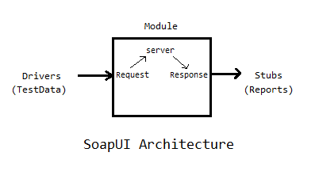
SoapUI Testing Architecture

Slide 7
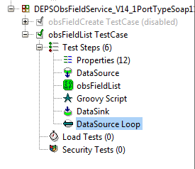
Creating SoapUI project

Slide 8
Data Source and Data Sink
Data Source holds the test data for SOAP request message
Excel, JDBC, XML, Groovy etc.
Data Sink contain test result and SOAP response data.
Excel, JDBC, XML, Groovy etc.

Slide 9
Groovy Script
To set input data in SOAP request message
To customize SOAP request according to input data
Validate SOAP response with the expected values
Set value to report
Notes:
A proximity sensor is a sensor able to detect the presence of nearby objects without any physical contact.
An accelerometer is a device that measures acceleration.
A gyroscope is a device for measuring orientation in 3D.
Ambient sensors are sensors capable of jointly sensing multiple physical phenomena in various surroundings – temperature, light.

Slide 10
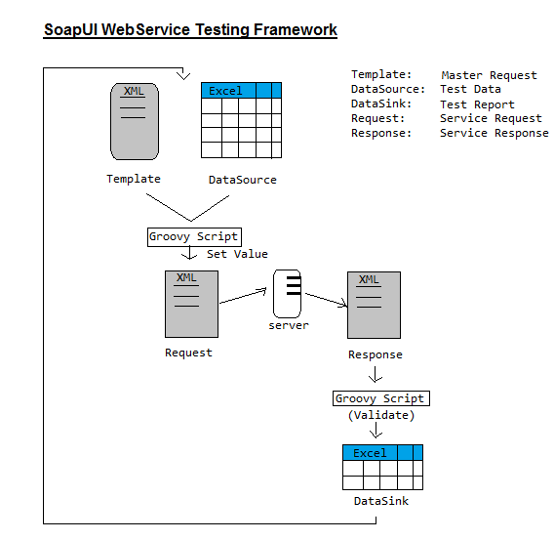

Slide 11
Thank You

